Slide 1
New methods for the iteration and visualization of the mandelbrot and julia sets
Embry-Riddle Aeronautical University
Dawson Brindle - Aerospace Engineering, Sophomore
Eric Babcock - Software Engineering, Sophomore
Mentored by: Dr. Mitch Hamidi & Dr. Lara Ismert
April 17, 2021
Arizona Space Grant Consortium
Embry-Riddle Aeronautical University

Slide 2
Project Goals
Focuses on two mathematical spaces:
The Mandelbrot Set
Julia Sets
Explore new constructions and visualizations using linear algebra
Application to computational efficiency
Discovery of new properties of these famous spaces
Notes:
Say: These spaces are subsets of the complex plane.
Say: These fractal constructions are known for being very beautiful and arising naturally. They are connected to the Fibonacci sequence and are generated by iterating functions repeatedly.

Slide 3
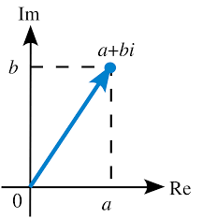
Complex Numbers
The imaginary number $i$…
$$x^{2}=−1$$
$$x=±\sqrt{−1}$$
$$x=±i$$
Notes:
Say: A complex number a+bi is...(refer to picture)

Slide 4
Building Blocks of the Mandelbrot & Julia Sets
$c$: root
$ω$: seed
𝑐: root
𝜔: seed
$$f_{c}(z)=z^{2}+c$$
𝑓_𝑐 (𝑧)=𝑧^2+𝑐
We iterate the seed $ω$ infinitely many times under the function $f_{c}$ to find its orbit.

Slide 5
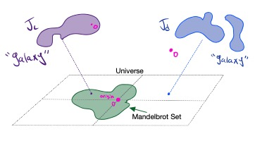
What do we mean by Orbit?
Plug $ω$ into $f_{c}\left(z\right)=z^{2}+c$ over and over:
$$ω →f_{c}\left(ω\right)→{f_{c}(f}_{c}(ω))→…$$
Two possible behaviors:
The orbit’s points tend to $∞$
The orbit’s points stay bounded
Notes:
Talk about seeds: “a seed is the number that is being tested to see if it is in the Julia set”
The Orbit of this function $f_{c}\left(z\right)=z^{2}+c$ at a seed $ω$ is the collection of all outputs you get by iteratively plugging in $ω$for z

Slide 6
Orbit Example 1
Root: $c=1$ → $f_{1}\left(z\right)=z^{2}+1$
Seed: $ω=1$
$$f_{1}\left(1\right)=1^{2}+1=2$$
$$f_{1}\left(2\right)=2^{2}+1=5$$
$$f_{1}\left(5\right)=5^{2}+1=26$$
$$⋮$$
The orbit of the seed $ω=1$ is unbounded.

Slide 7
Orbit Example 2
Root: $c=i$ →$f_{i}\left(z\right)=z^{2}$ + $i$
Seed: $ω$= $i$
$$f_{i}\left(i\right){=i}^{2}+ i=i−1$$
$$f_{i}\left(i−1\right){=(i−1)}^{2}+ i=−i$$
$$f_{i}\left(−i\right){=(−i)}^{2}+ i=i−1$$
$$⋮$$
The orbit of the seed $ω=i$ is bounded.

Slide 8
Membership in the Mandelbrot Set
$ω$ belongs to the Mandelbrot set $↔$ the orbit of $ω$ is bounded for itself as a root ($c=ω$).
Ex. 1: The seed $ω=1$ (under root $c=1$) is NOT in the Mandelbrot set because its orbit $1, 2, 5, 26,…$tends to $∞$
Ex. 2: The seed $ω=i$ (under root $c=i$) is in the Mandelbrot set because its orbit $i, i−1, −i, i−1…$ stays close to the origin
Notes:
Replace definition: O_c is in M if O_c is bounded

Slide 9
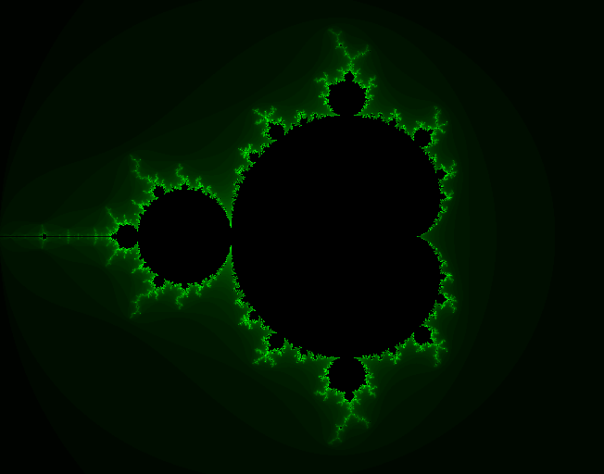
Figure 1: Mandelbrot Set
created in C++ by researcher Eric Babcock

Slide 10
Applications of Fractal Geometry
Video games
Fashion
Cyber security
Space travel
Probabilities

Slide 11
Challenge & Framework
Iterating complex-valued functions is computationally difficult.
For example, there is no closed formula for the coefficients of the iterations of $f_{c}.$
We can translate studying these iterated functions to studying sequences of matrices by viewing the complex numbers as a 2-dimensional $ℝ$-vector space.
Notes:
1) Function iterations can become complicated and taxing.
2) The fact that the complex plane can be thought of as a 2-dimensional real vector space.
3) allows us to replace function iterations with matrix multiplication.

Slide 12
The “Translation” for $c=a+bi$
(Classical) Function Framework
(BBHI) Matricial Framework
$f_{c}\left(c\right)=c^{2}+c$
$f_{c}\left(f_{c}\left(c\right)\right)={\left(c^{2}+c\right)}^{2}+c$
$$⋮$$
Determine the boundedness of
$\left\{f_{c}\left(c\right),f_{c}\left(f_{c}\left(c\right)\right),f_{c}\left(f_{c}\left(f_{c}\left(c\right)\right)\right),…\right\}$
$\left(\left[\begin{matrix}a & −b & 0 \\ 2b & 0 & 0 \\ 0 & 0 & 0\end{matrix}\right]+\left[\begin{matrix}0 & 0 & a \\ 0 & 0 & b \\ 0 & 0 & 1\end{matrix}\right]\right)\left[\begin{matrix} a \\ b \\ 1\end{matrix}\right]=\left[\begin{matrix}a_{1} \\ b_{1} \\ 1\end{matrix}\right]$
$$a_{1}+b_{1}i≔$$
$$\left(\left[\begin{matrix}a_{1} & −b_{1} & 0 \\ 2b_{1} & 0 & 0 \\ 0 & 0 & 0\end{matrix}\right]+\left[\begin{matrix}0 & 0 & a \\ 0 & 0 & b \\ 0 & 0 & 1\end{matrix}\right]\right)\left[\begin{matrix} a_{1} \\ b_{1} \\ 1\end{matrix}\right]=\left[\begin{matrix}a_{2} \\ b_{2} \\ 1\end{matrix}\right]$$
$$⋮$$
$$=:M(a,b)$$
$$a_{2}+b_{2}i≔$$
$$=:M(a_{1},b_{1})$$
Determine the “boundedness” of
$\left\{M\left(a,b\right),M\left(a_{1},b_{1}\right),M(a_{2},b_{2}),…\right\}$
Notes:
Say: What you see on the left is the first two iterations in the orbit of seed c under root c.
[Transition 1]
Say: We can just label these two iterations by the complex numbers a1+b1i and a2+b2i, where a1 and a2 are the real parts and b1 and b2 are imaginary parts.
[Transition 2]
For membership in the Mandelbrot set, we need to see if the orbit is bounded or not.
[Transition 3]
Let's translate the complex numbers in blue on the left into vectors [a b 1], [a1 b1 1], and [a2 b2 1].

Slide 13
Theorem (BBHI, 2021)
$a+bi$belongs to the Mandelbrot set if and only if
$\left\{M\left(a,b\right),M\left(a_{1},b_{1}\right),M(a_{2},b_{2}),…\right\}$
is uniformly bounded in operator norm.

Slide 14
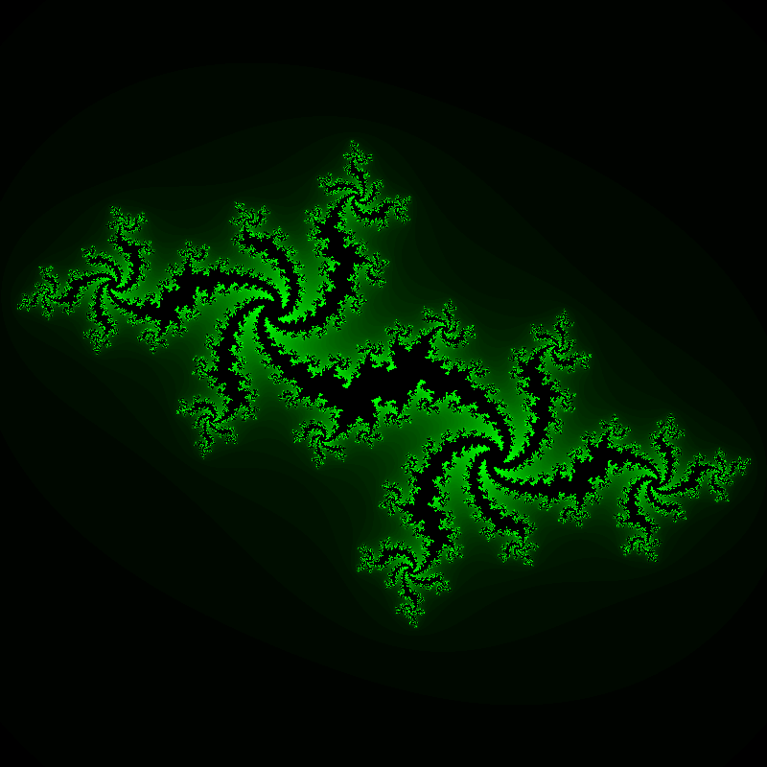
jULIA SETs
THEOREM BBHI ​
Figure 2: Image of Julia Set for $c = −0.54 + .54i​$
created in C++ by researcher Eric Babcock
Notes:
Mention an infinite number of Julia Sets to 1 Mandelbrot set

Slide 15
What’s an orbit again?
The orbit of $ω$ under $c$ is constructed by plugging $ω$ into $f_{c}\left(z\right)=z^{2}+c$ over and over: $ω →f_{c}\left(ω\right)→{f_{c}(f}_{c}(ω))→…$
And remember, there are two possible behaviors:
The orbit’s points tend to $∞$
The orbit’s points stay bounded
Mandelbrot Set v. Julia Sets
Mandelbrot membership $ω=c$
Julia membership….any seed for any root
Notes:
Okay we are going to be talking about Julia Sets, but to do so, we need to remind you what an orbit is
Mention boundedness of behaviors
So now to compare Mandelbrot v Julia Sets-
In the Mandelbrot set, we take each point in the complex plane and iterate by using that point as both the seed and the constant root
In the Julia Set, we take one constant root, and iterate every point in complex the plane

Slide 16
Orbit Example 3
Root: $c=i$ → $f_{i}\left(z\right)=z^{2}+i$
Seed: $ω=2i$
$$f_{i}\left(2i\right){=(2i)}^{2}+ i=−4+i$$
$$f_{i}\left(−4+i\right){=(−4+i)}^{2}+ i=15−7i$$
$$f_{i}\left(15−7i\right){=(15−7i)}^{2}+ i=176−209i$$
$$⋮$$
The orbit of the seed $ω=2i$ is unbounded.
Notes:
For this slide we have an example of an orbit, notice that in case our seed != root. So as we iterate, if you look at the value of each iteration it is obvious that these results are blowing up towards infinity

Slide 17
Orbit Example 4
Root: $c=−1$ → $f_{−1}\left(z\right)=z^{2}−1$
Seed: $ω=1$
$$f_{−1}\left(1\right){=(1)}^{2}−1=0$$
$$f_{−1}\left(0\right){=(0)}^{2}−1=−1$$
$$f_{−1}\left(−1\right){=(−1)}^{2}−1=0$$
$$⋮$$
The orbit of the seed $ω=1$ is bounded.

Slide 18
Membership in a Julia Set
For a fixed root $c,$
a seed $ω$ belongs to the Julia Set for $c$, denoted $𝒥_{c}$, if and only if
$$\left\{ω,f_{c}\left(ω\right),f_{c}\left(f_{c}\left(ω\right)\right),f_{c}\left(f_{c}\left(f_{c}\left(ω\right)\right)\right),…\right\}$$
is bounded.
Ex. 3: The seed $ω=2i$ is NOT in $𝒥_{i}$ because its orbit $2i, −4+i, 15−7i, 176−209i,…$(under root $c=i$) tends to $∞$
Ex. 4: The seed $ω=1$ is in $𝒥_{−1}$ because its orbit $1,0,−1,0,−1,0,…$ (under root $c=−1$) stays close to the origin
Notes:
Format example

Slide 19
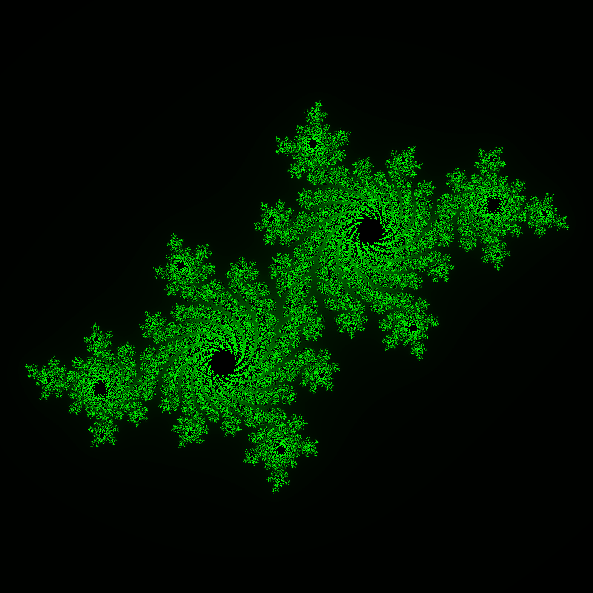
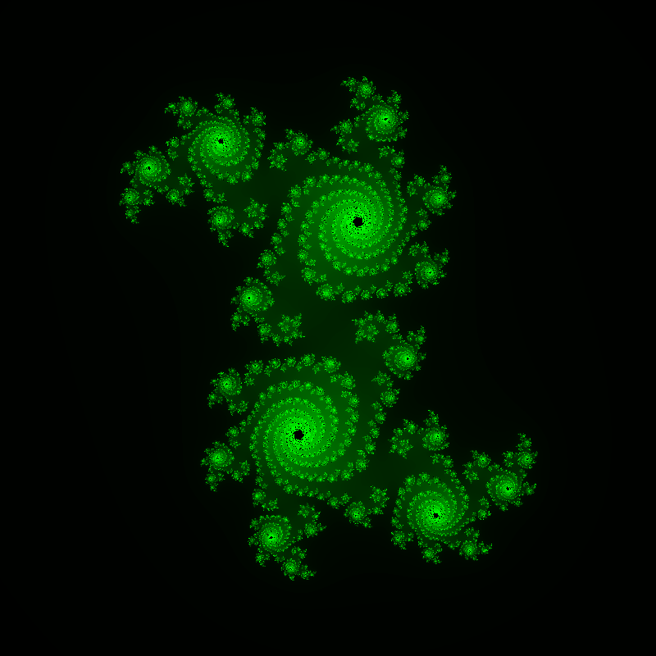
More Julia Sets
c = −.4 -.59i​
c = −0.54 + .54i​
c = 0.355 +0.355i​
Notes:
Add new slide

Slide 20
Julia Sets and the Mandelbrot Set
c = −0.54 + .54i​
Notes:
0) Complex numbers = universe, Mandelbrot set is at the "center" of our universe.
1) Introduce purple and blue blobs, two Julia sets (out of infinitely many).
2) Notice that 0 is in the purple blob, but not the blue blob. You can ask if a Julia set has enough gravitational force to pull itself into a single blob (purple) or not (blue).
3) Notice also that c, the root for the purple blob, belongs to the Mandelbrot set, while d, the root for the blue blob, does not belong to Mandelbrot set.
4) This is another way to characterize membership in the Mandelbrot set.
5) Yet another way to characterize membership in the Mandelbrot set is if the Julia set is what's called "connected."

Slide 21
New Notation:
$z_{n+1}=z_{n}^{2}+c$,
where z and c are complex numbers:
$z_{n}=x_{n}+{iy}_{n} c=a+ib$.
We have
$z_{n+1}=x_{n+1}+{iy}_{n+1}$,
and in fact
$$x_{n+1}=x_{n}^{2}−y_{n}^{2}+a$$
$$y_{n+1}=2x_{n}y_{n}+b$$
Julia Sets via Affine Transformations part 1
Notes:
1) Talk about defining z recursively
2) Talk about splitting complex numbers into real and imaginary parts

Slide 22
Julia Sets via Affine Transformations part 2
$$z_{n}=x_{n}+{iy}_{n} c=a+ib$$
Let $J\left(x_{n},y_{n},a,b\right)$denote the linear transformation pertaining to $c$ which satisfies:
$$J\left(x_{n},y_{n},a,b\right)∗\overset{⃑}{z_{n}}=\overset{⃑}{z_{n+1}}$$
where $\overset{⃑}{z_{n}}$ and $\overset{⃑}{z_{n+1}}$ are the column vectors
$\overset{⃑}{z_{n}}≔\left[\begin{matrix}x_{n} \\ y_{n} \\ 1\end{matrix}\right], \overset{⃑}{z_{n+1}}:=$ $\left[\begin{matrix}x_{n+1} \\ y_{n+1} \\ 1\end{matrix}\right]=\left[\begin{matrix}x_{n}^{2}−y_{n}^{2}+a \\ {2x_{n}y}_{n}+b \\ 1\end{matrix}\right]$
From these conditions, we derived
$$J\left(x_{n},y_{n},a,b\right)=\left[\begin{matrix}x_{n} & −y_{n} & a \\ 2y_{n} & 0 & b \\ 0 & 0 & 1\end{matrix}\right]$$
$$\left(\left[\begin{matrix}x_{n} & −y_{n} & 0 \\ 2y_{n} & 0 & 0 \\ 0 & 0 & 1\end{matrix}\right]+\left[\begin{matrix}0 & 0 & a \\ 0 & 0 & b \\ 0 & 0 & 1\end{matrix}\right]\right)$$

Slide 23
Theorem (BBHI, 2021)
$x+yi$belongs to $𝒥_{a+ib}$ if and only if
$\left\{J\left(x,y,a,b\right),J\left(x_{1},y_{1},a,b\right),J(x_{2},y_{2},a,b),…\right\}$
is uniformly bounded in operator norm.

Slide 24
An Example
400 iterations with $ω=−0.25$ with root $$c=−0.54+0.54i$$
Iterations 400 to 413 with $ω=−0.25$ with root $$c=−0.54+0.54i$$

Slide 25
What we are working on now
What can the eigenvalues of these matrices tell us about membership in a set?
Can we get an error bound or analysis of determining in the Mandelbrot set a finite (small) number of matrix iterations? Certainty bound?
Proving classical results using our new methods for iteration
Can we find the center value of the largest connected disc in the Mandelbrot set?

